Slide 1
Best Price

Slide 2
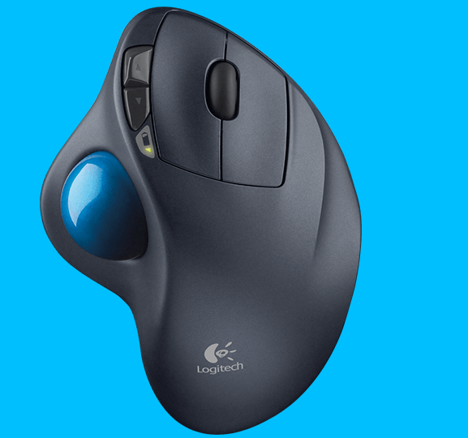
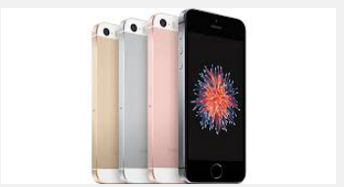
Do you desperately want something?

Slide 3

But you don’t want to wait for shipping

Slide 4
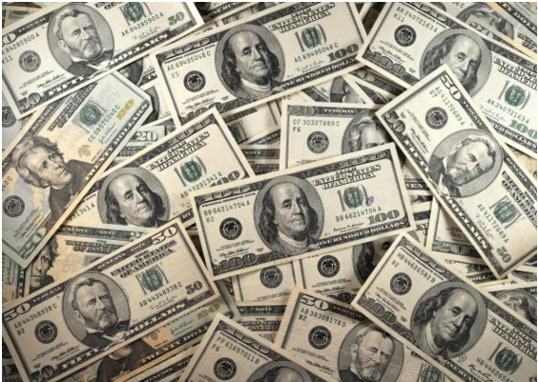
And you want the best price

Slide 5
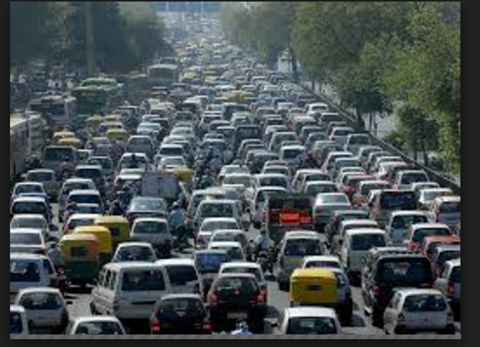
And you don’t want to drive Too far…

Slide 6
Then we’ve got the app for you!
Tells you the closest store with your dream product at the lowest price!!!!!

Slide 7
Future Improvements
UI Design
Android/Windows Support
Improved error handling
More stores
UPC database / custom query matching

Slide 8

Questions?

